Slide 1

Red Ocean Locator
IBM Data Science Capstone – Oct. 2018

Slide 2
Synopsis
Business Case
For a group of entrepreneurs who would like to start their own restaurant,
the location is critical. the perfect location would be a place where there is medium to high density of restaurant – the so-called Red Ocean.
The Red Ocean is analogous to a shark infested ocean where the sharks are fighting each other for the same prey
Instead of competing head to head with same restaurant type, the strategy is to make the competition irrelevant simply by opening up a service which does not exist yet.
This approach is directly derived from the blue ocean marketing strategy.
Our Red Ocean locator will provide entrepreneurs a list of neighbourhoods shaping the red ocean.

Slide 3
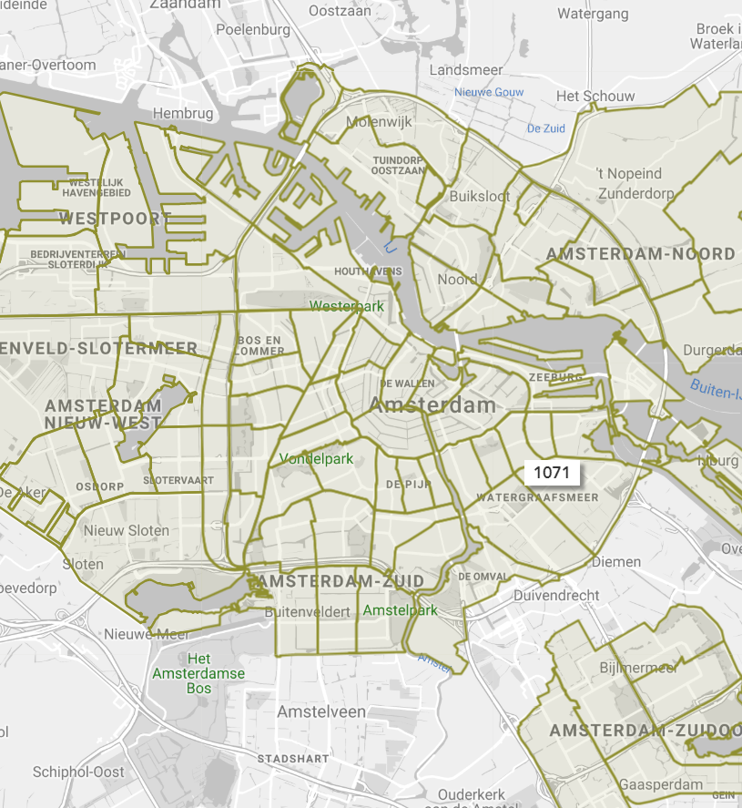
Data pre-requisites (1)
Geo-locational information about all the city neighbourhood will be required (latitude and longitude)
The city selected for this project will be Amsterdam as the entrepreneurs are Dutch and wishes to invest in this city
Neighborhoods in Amsterdam will be identitified by their corresponding Postal Codes.
Data Source : https://maps.amsterdam.nl/

Slide 4
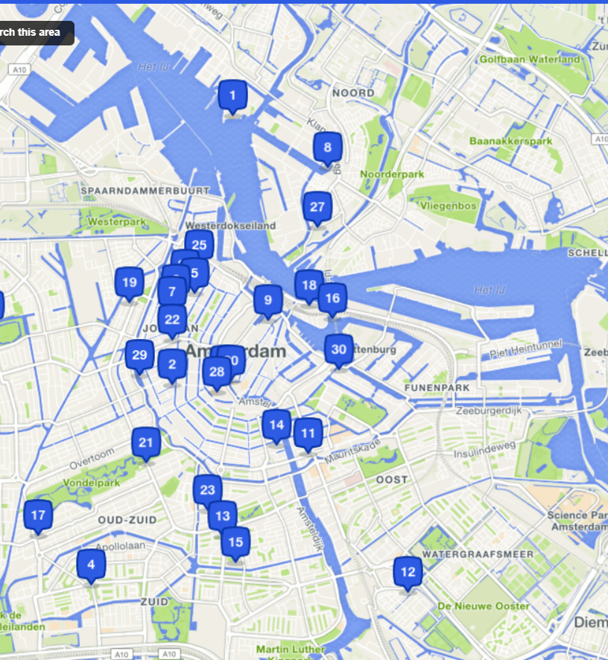
Data pre-requisites (2)
Data about different venues including restaurants in different neighborhoods will also be required.
The dataset will be provided by "Foursquare" through an API call and data will be collected in JSON format. The JSON file will return basic and advanced information about each venue
Foursquare is a local search-and-discovery service mobile app which provides search results for its users. The app provides personalized recommendations of places to go to near a user's current location based on users' "previous browsing history, purchases, or check-in history"

Slide 5
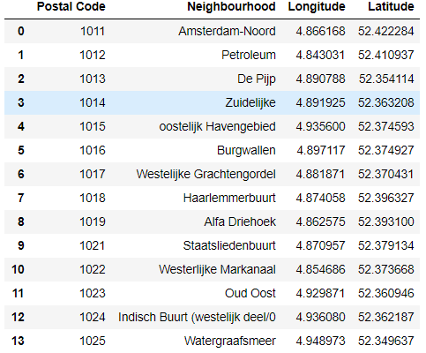
Step 1 – Identifying Amsterdam Neighbourhoods

Slide 6
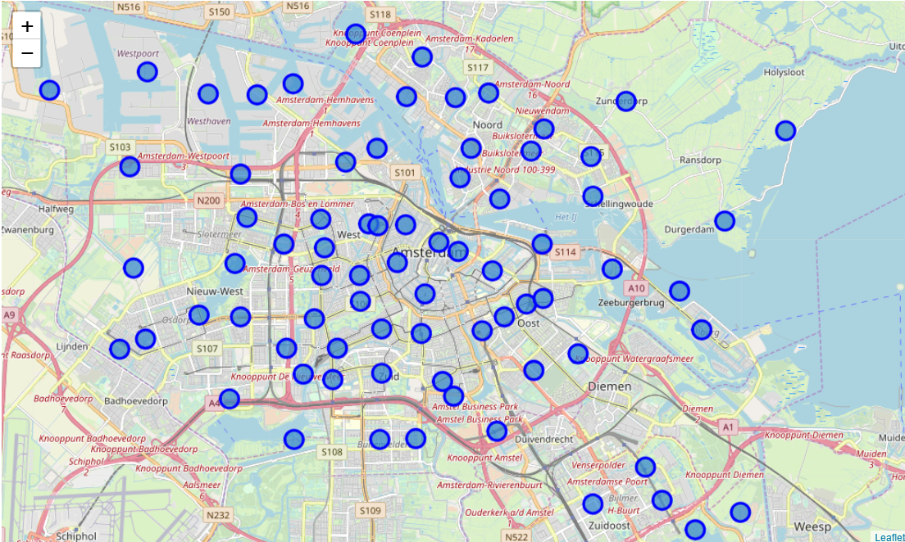
Step 2 – Visualizing the postal code and neighbourhood

Slide 7
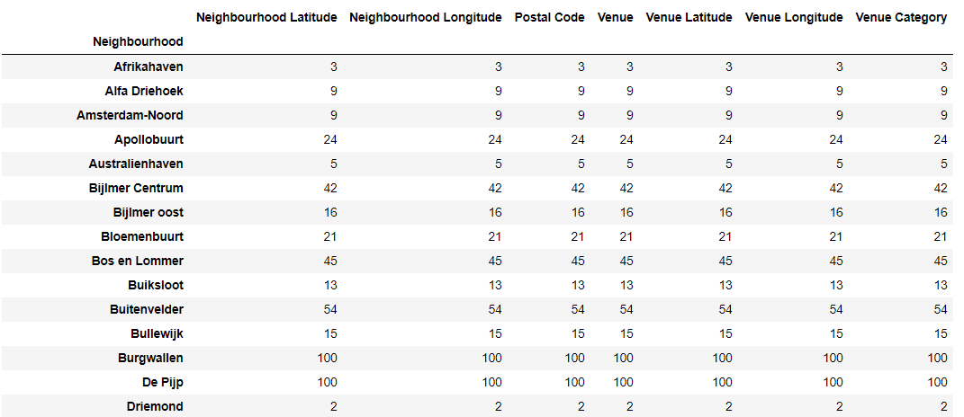
Step 3 - Connecting to Foursquare and Retrieving Venue Data for Each Neighborhood
Once the list of neighborhoods is completed, a request to the Foursquare API is made to gather information about venues inside each and every neighborhood. The default radius is the neighbourhood boundary

Slide 8
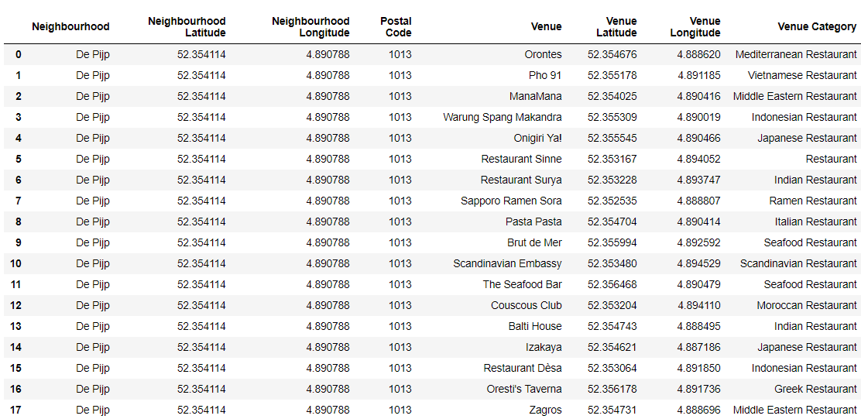
Step 4 - Preparing Data and Creating a Dataframe for the all the restaurant Venues in Amsterdam
Since we want to focus only on restaurant to identify red ocean, we will filter out all the categories which do not point of refer to restaurant.

Slide 9
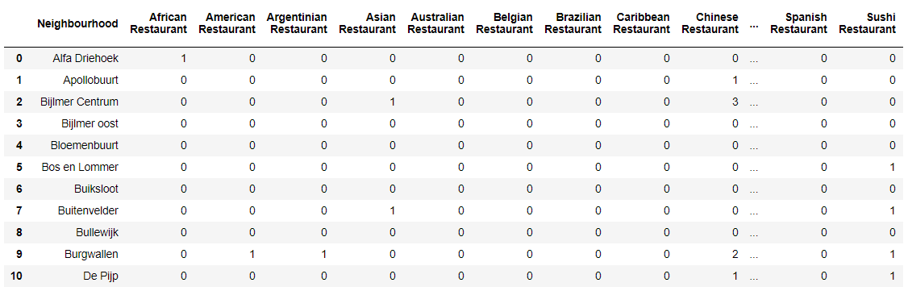
Step 5 – One Hot Encoding
After this stage, the venue category (52 restaurant categories) gets One-hot encoded After On-hot encoding, a new dataframe is created to group all the restaurant per neighbourhood with an extra column displaying the total restaurant per neighbourhood

Slide 10
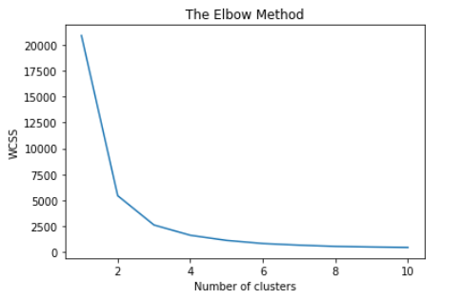
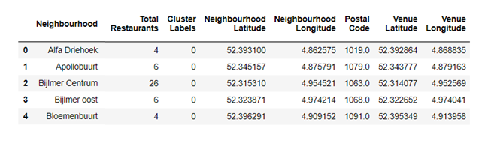
Step 6 – K-Means Clustering
Before we start clustering our data, we use the silhouette score and the elbow method to determine the ideal number of clusters
The conclusion is that 3 clusters is enough and will cover the complexity of our problem
After clustering we update our dataset by adding the neighbourhood column and the cluster label column representing the cluster for each neighborhood

Slide 11
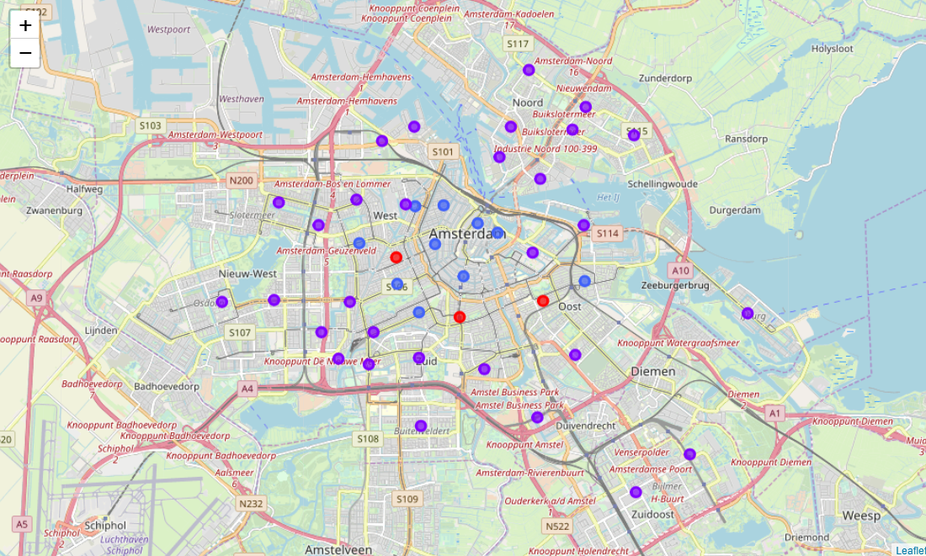
Step 7 – Results and Recommendation (1)
At this stage, clusters can be visualized on a map with different colours. You can consider Amsterdam to be a big circle with its downtown in the center. Cluster 0 (red) and Cluster 2 (Blue) shows mostly restaurant in the downtown area while cluster 0 (purple) shows restaurant mostly located between the outer edge of the downtown and the city limit

Slide 12
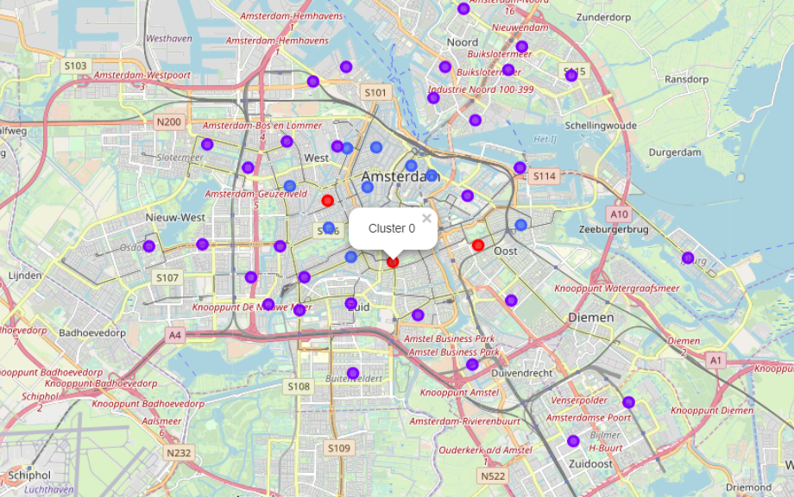
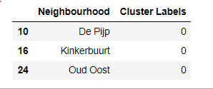
Step 7 – Results and Recommendation (1)
Looking further into each cluster, we can identify each neighborhood and the total number of restaurants. Red Ocean (Red Cluster),shows three neighbourhoods with 70 to 90 restaurants.

Slide 13
Step 7 – Results and Recommendation (3)
Based on the machine learning output, we would advise these investors to look for a location in De Pijp, Kinkerbuurt and Oud Oost (Cluster #0 – highlighted in Yellow) where there is the highest concentration of restaurants and then of course to choose for a different type of food service offering … to go into the blue ocean !

Slide 14
Conclusions
Nice project to work with location data from multiple sources
Concrete use case of machine learning for marketing/targeting exercise

